Slide 2
Lecture 2: Biodiversity Maintenance:
Mechanisms and Metacommunities

Slide 3
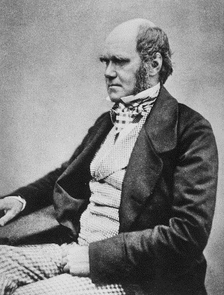
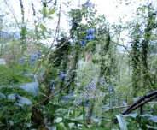
Entangled Bank
“As the species of the same genus usually have…much similarity in habits and constitution…the struggle will generally be more severe between them, if they come into competition with each other, than between the species of distinct genera.”

Slide 4
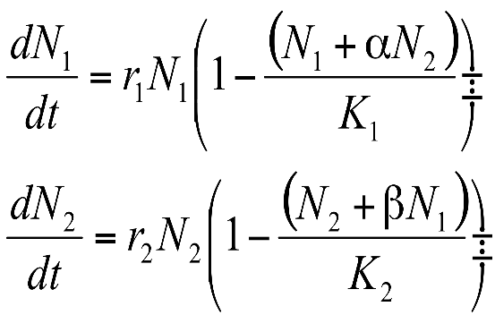

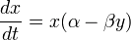
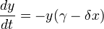
Lotka-Volterra: Interactions and Coexistence
Competition
Predator-Prey
Alfred Lotka
Vito Volterra

Slide 5
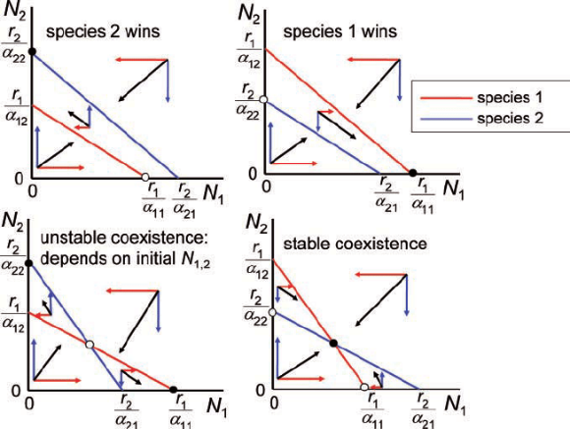
Lotka-Volterra Competition and Coexistence
Species with Highest Isocline wins
Coexist when Intraspecific effects > Interspecific effects
Priority effects when Intraspecific effects < Interspecific effects

Slide 6
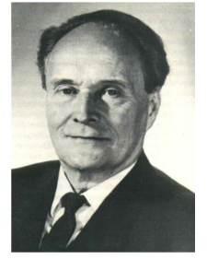
Gause 1934

Slide 7
Hardin G (1960) The competitive exclusion principle. Science 131:1292-1297
“It may be stated thus:
Complete competitors cannot coexist.”

Slide 8
Back to Square 1:
N_{t}=Population in the current time step
N_{t+1}=Population in the next time step (t +1)
B=# Births
I=# of Immigrants
D=# Deaths
E=# Emigrants
Present→ B>D
Absent→ B<D
(in a closed population)

Slide 9
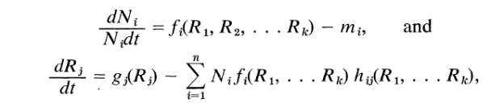
“Traditional models of competition, which form the basis of much of current ecological thought and theory, are non-mechanistic.”
Tilman 1982

Slide 10
The R* Principle
growth
Growth rate dN/Ndt
loss
R*
[R]

Slide 11
Two ‘parts’ of the Niche
growth
Requirement Niche
(Grinnell, Hutchinson—what a species needs)
Growth rate dN/Ndt
The ‘Impact’ Niche
(Elton—what a species does)
loss
R*
[R]

Slide 12
The R* Principle
A
Growth rate dN/Ndt
B
R*_{B}
R*_{A}
[R]
Two species together…the species with the lowest R* always wins
….when there is only one limiting resource, and the system is at equilibrium
…But, then how do species coexist??

Slide 13
A
Growth rate dN/Ndt
B
R*_{B}
R*_{A}
[R]
Requirement Niche>>Impact Niche
When only one resource…

Slide 14
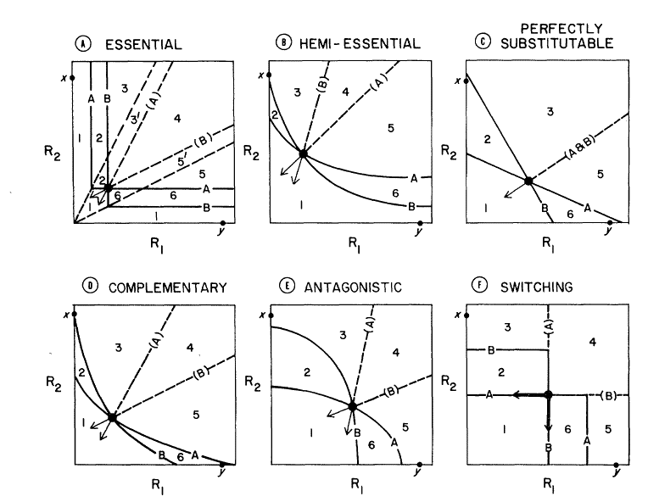
But what about when >1 resource?
(nitrogen, phosphorus, light, water, etc)
Resource 2
Tilman 1982
Resource 1
MacArthur 1972

Slide 15
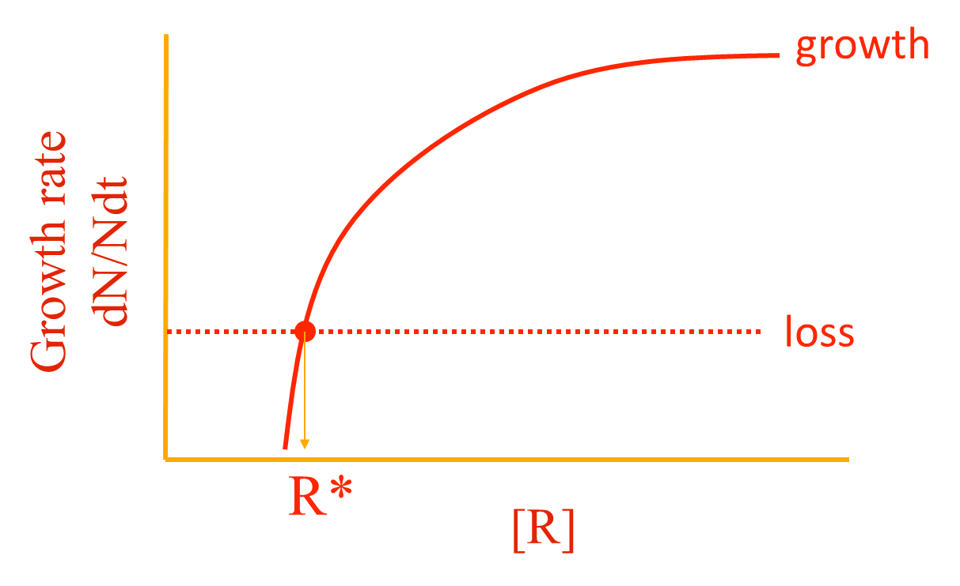
Building a Zero Net Growth Isocline (ZNGI): Essential Resources
(Requirement Niche in 2 Dimensions)
Inside requirement Niche
R2
[R₂]
A
Outside requirement Niche
[R₁]
R1

Slide 16
The Impact Vector
(the impact niche in 2 dimensions)
[R₂]
[R₁]

Slide 17
Two Species ZNGIs (Coexistence?)
A only
???
[R₂]
A
B only
B
[R₁]

Slide 18
Coexistence Requires Joint Trade-Offs
A only
A & B
[R₂]
A
B only
B
[R₁]

Slide 19
Unstable Coexistence and Priority Effects
A or B
(priority effects)
A only
[R₂]
A
B only
B
[R₁]
When impact vectors are reversed (species has greater impact on resource least limiting)

Slide 20
Species can’t be too similar……
….but, they also can’t be too different
Chesson’s (2000) General Theory of Coexistence
Coexistence depends on the ratios of:
→Stabilizing Mechanisms (Can’t be too similar)
-Niche differences
→Equalizing Mechanisms (Can’t be too different) -Fitness differences
Modern Coexistence Theory (MCT)
Possible Coexistence
Possible Coexistence
Resource A
Resource B

Slide 21
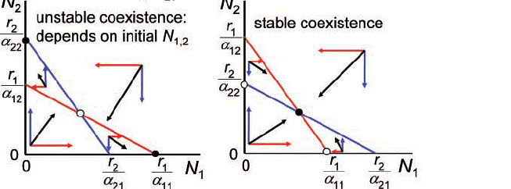
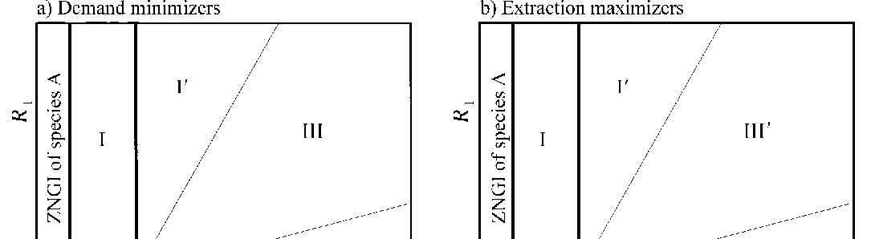
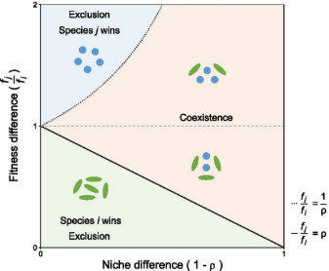
Lotka-Volerra
Consumer-Resource/Niche
Modern Coexistence Theory (MCT)
Coexistence:
Intraspecific effects > Interspecific Effects
Priority effects:
Intraspecific effects < Interspecific Effects
Neutral:
Intraspecific effects = Interspecific Effects

Slide 22
Other factors that influence coexistence:
Time—Intrinsic and extrinsic
Space—Heterogeneity, dispersal
Simple view:
-1 resource=1 species
-2 resources=2 species
-N resources=N species
But often:
-N Resources << N species
Interactions between them
Frequency Dependence, colonization competition
Space, time and predation
--Janzen-Connell effects
Other limiting factors:
Disturbance/Stress
Apparent Competition via Shared Predators
Keystone Predation

Slide 23
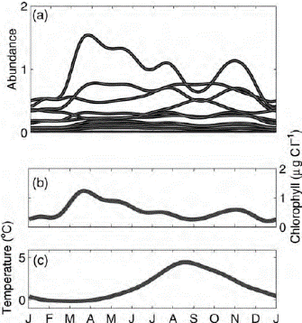
Adding temporal variation to allow coexistence
Problem→too many phytoplankton for Number of resources
Hutchinson GE (1961) The paradox of the plankton. American Naturalist
Solution→Seasonality/Movement in water colume keeps things from Outcompeting each other
Early ‘Neutral’ Perspective
There is a possibility that these organisms are so nearly equal in their ability to compete that they do not eliminate each other
Riley 1963

Slide 24
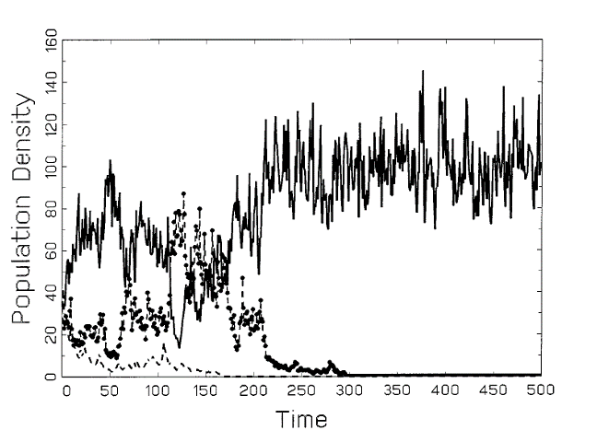
But Seasonality and Fluctuations not enough: Need Trade-Offs!
Chesson and Huntly 1997, American Naturalist

Slide 25
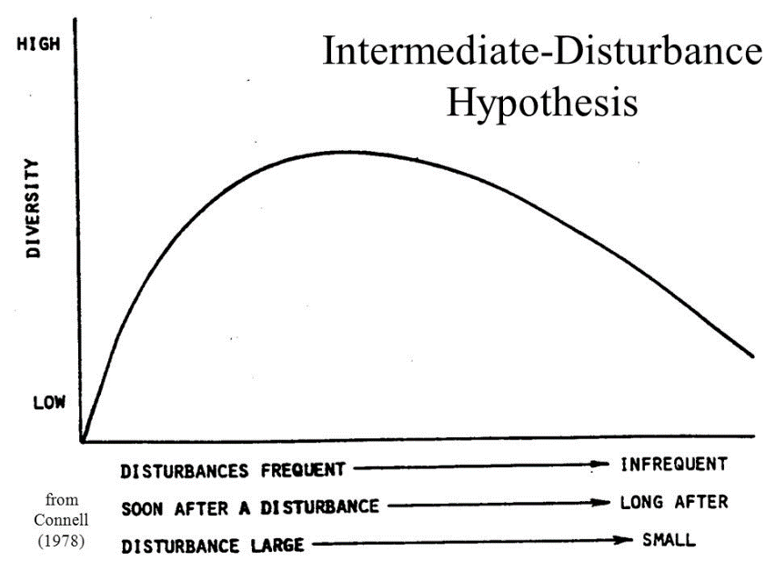
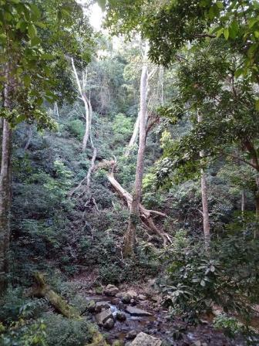
Connell (1978): Intermediate Disturbance Hypothesis
Connell 1978; Intermediate Disturbance Hypothesis

Slide 26
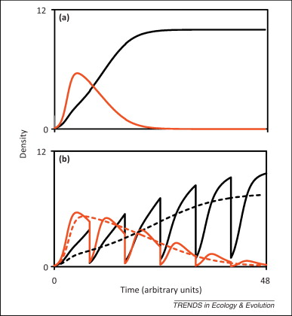
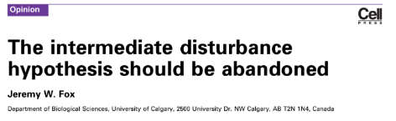
Disturbance not enough: Need Trade-Offs!

Slide 27
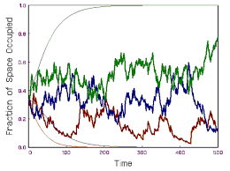
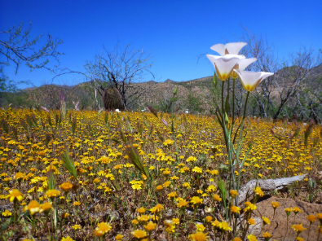

The ‘Storage’ Effect: Trade-offs in time
‘Store’ as Long-lived Seeds
Trade-offs in growth vs. seed longevity
‘Store’ as Long-lived adults
Trade-offs in reproduction vs. longevity
Chesson 2000

Slide 28
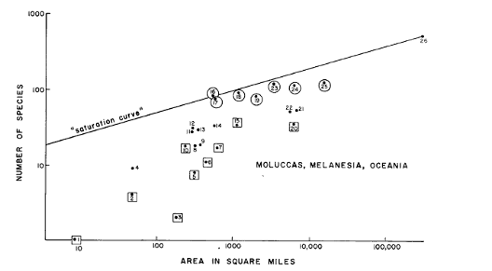
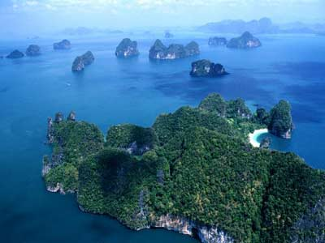
The role of space… Dispersal Limitation
MacArthur and Wilson 1963

Slide 29
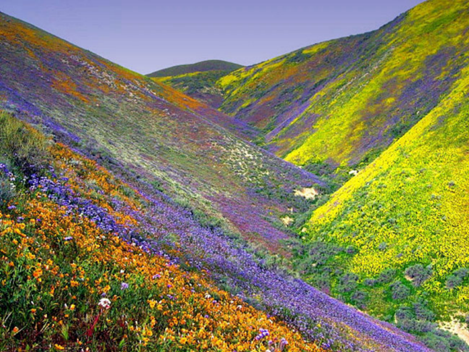
Adding Space:
Spatial processes influence Coexistence → metacommunity
Habitat heterogeneity → Species Sorting

Slide 30
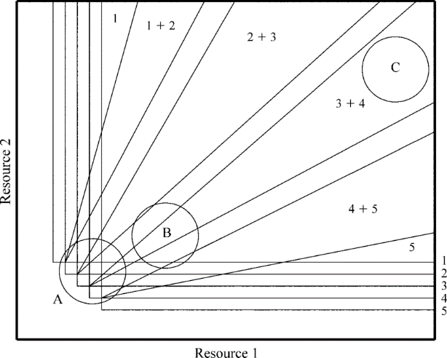
Many Species, 2 resources (with spatial heterogeneity)
Resource Supply
Tilman and Pacala 1993

Slide 31
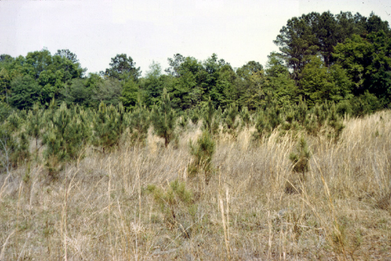
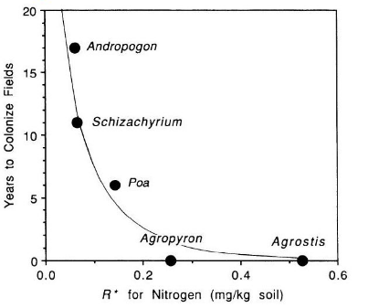
Space and Time: Competition-Colonization Trade-Off

Slide 32
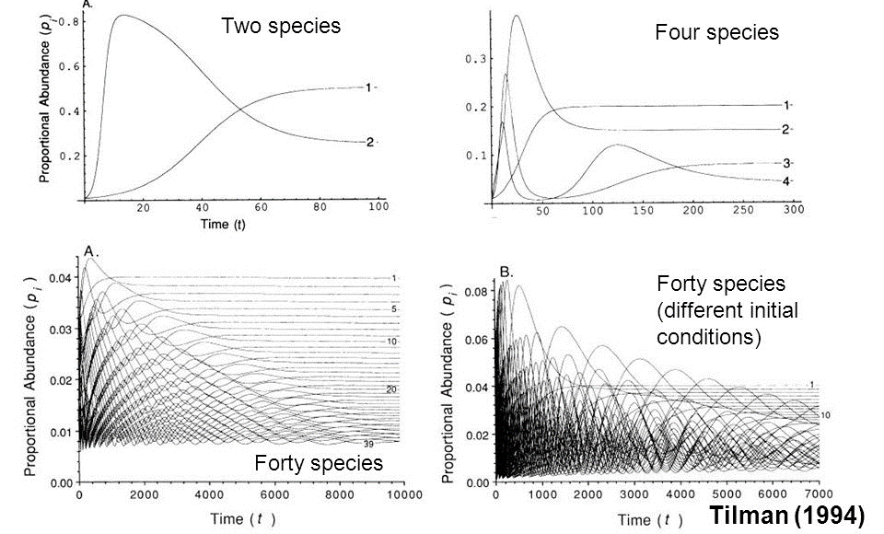
Space and Time: Competition-Colonization Trade-Off

Slide 33
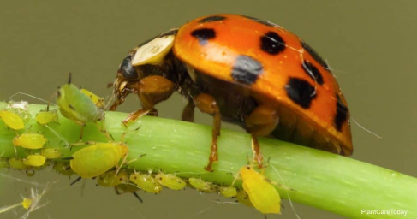

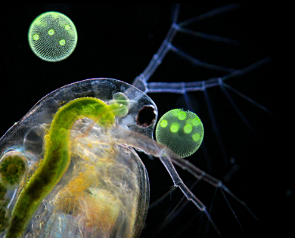
Other limiting factors: Enemies, Stress

Slide 34
Metacommunities: The role of space
(Heterogeneity, dispersal)

Slide 35


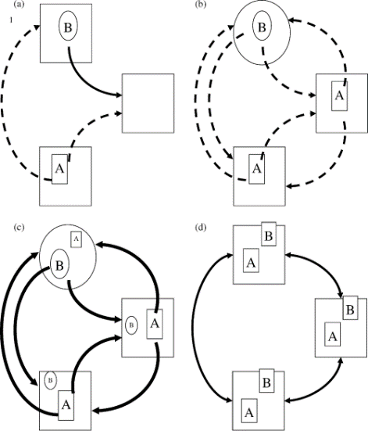
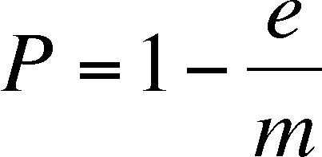



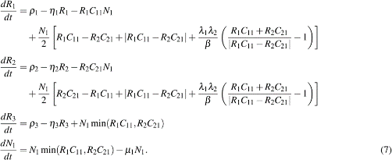
Leibold et al. 2004, Ecology Letters

Slide 36
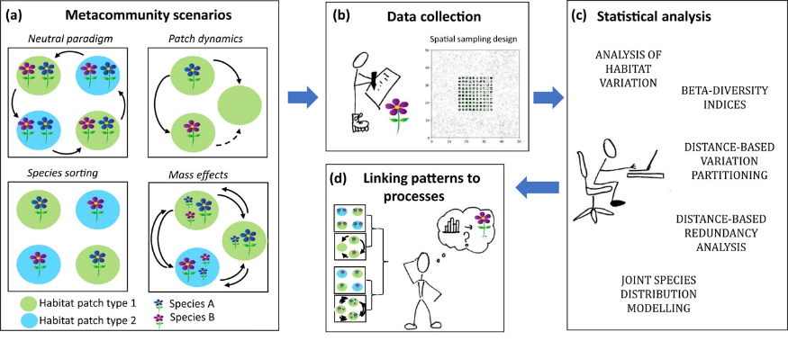
Ovaskainen et al. 2019. Ecography

Slide 37
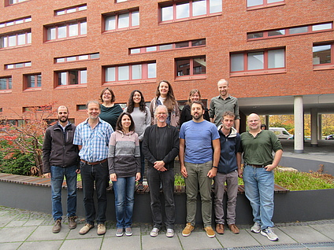
Can we make a better metacommunity model?
For theory and data analyses?

Slide 38
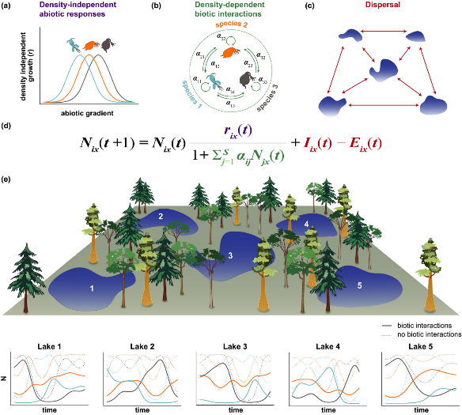
Processes instead of Paradigms
Thompson et al. 2020 Ecology Letters

Slide 39
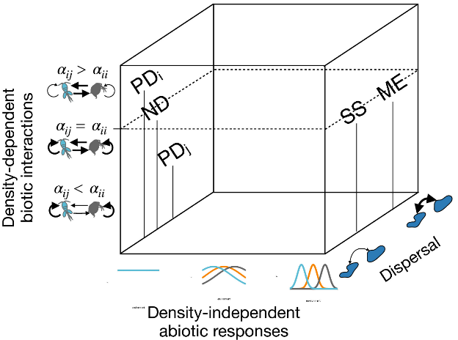
The 4 paradigms only represent a small amount of the possible space

Slide 40
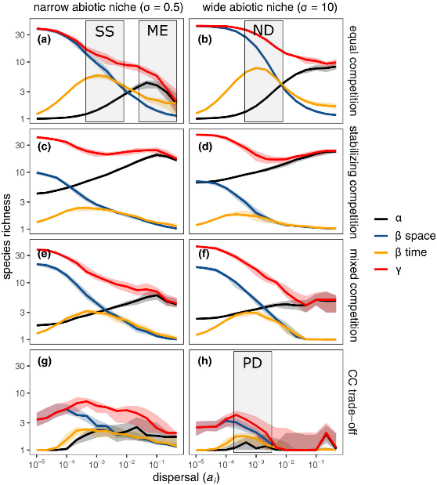
The 4 paradigms only represent a small amount of the possible space

Slide 41
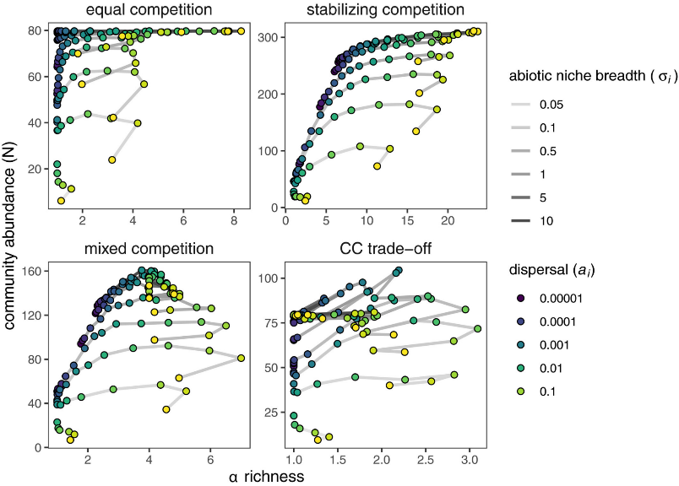
Other response variables: Ecosystem Function

Slide 42
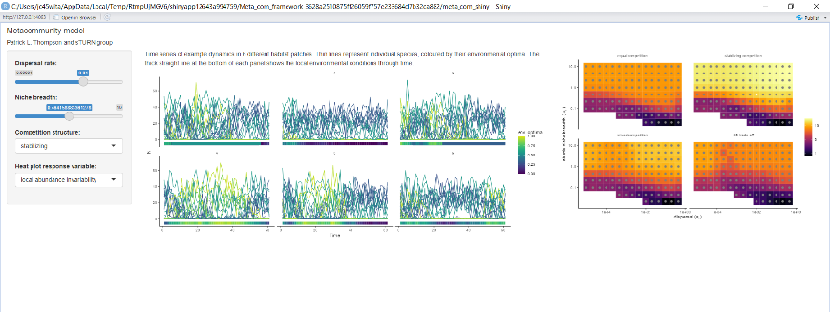
install.packages(c('shiny', 'shinyBS', 'shinyWidgets','tidyverse','ggExtra','viridis','cowplot'))
shiny::runGitHub("plthompson/Meta_com_framework", subdir = "meta_com_shiny")

